Slide 1
How to create synthetic data
A tool for open science
Erik-Jan van Kesteren
Raoul Schram
Thom Volker
Utrecht University
ODISSEI Social Data Science team

Slide 2
Imagine..

Slide 3






Notes:
Imagine you’re a researcher. Maybe a social scientist with a great idea about how our physical environment influences our spending patterns.
Scientist by Justicon from <a href="https://thenounproject.com/browse/icons/term/scientist/" target="_blank" title="Scientist Icons">Noun Project</a>
Idea by Icon Master from <a href="https://thenounproject.com/browse/icons/term/idea/" target="_blank" title="Idea Icons">Noun Project</a>
house tree by LUTFI GANI AL ACHMAD from <a href="https://thenounproject.com/browse/icons/term/house-tree/" target="_blank" title="house tree Icons">Noun Project</a>
Euro by Larea from <a href="https://thenounproject.com/browse/icons/term/euro/" target="_blank" title="Euro Icons">Noun Project</a>

Slide 4

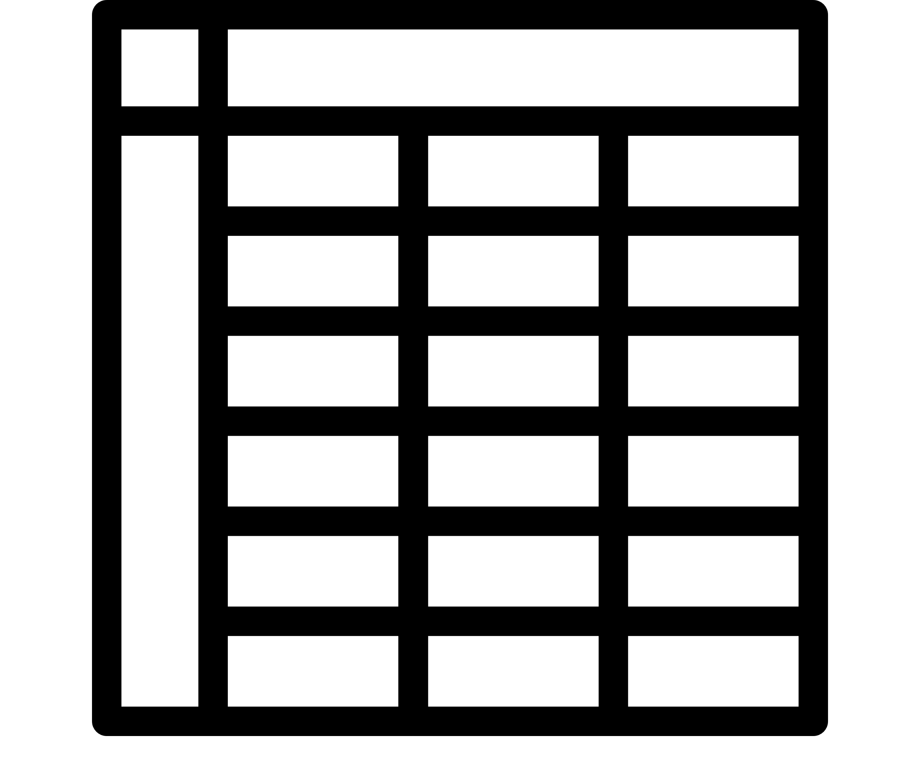
Where do you live?
How long have you lived there?
What do you earn?
How much do you spend on gifts for your friends?
Notes:
So you ask a large group of people a few questions and you record it in a data file.
Scientist by Justicon from <a href="https://thenounproject.com/browse/icons/term/scientist/" target="_blank" title="Scientist Icons">Noun Project</a>
Idea by Icon Master from <a href="https://thenounproject.com/browse/icons/term/idea/" target="_blank" title="Idea Icons">Noun Project</a>
house tree by LUTFI GANI AL ACHMAD from <a href="https://thenounproject.com/browse/icons/term/house-tree/" target="_blank" title="house tree Icons">Noun Project</a>
Euro by Larea from <a href="https://thenounproject.com/browse/icons/term/euro/" target="_blank" title="Euro Icons">Noun Project</a>
people by Alice Design from <a href="https://thenounproject.com/browse/icons/term/people/" target="_blank" title="people Icons">Noun Project</a>
Table by Alex Burte from <a href="https://thenounproject.com/browse/icons/term/table/" target="_blank" title="Table Icons">Noun Project</a>

Slide 5

Notes:
Then, you take your data file and write this awesome complicated script that processes it and produces an answer to your question
Hacking by Alfredo @ IconsAlfredo.us from <a href="https://thenounproject.com/browse/icons/term/hacking/" target="_blank" title="Hacking Icons">Noun Project</a>

Slide 6
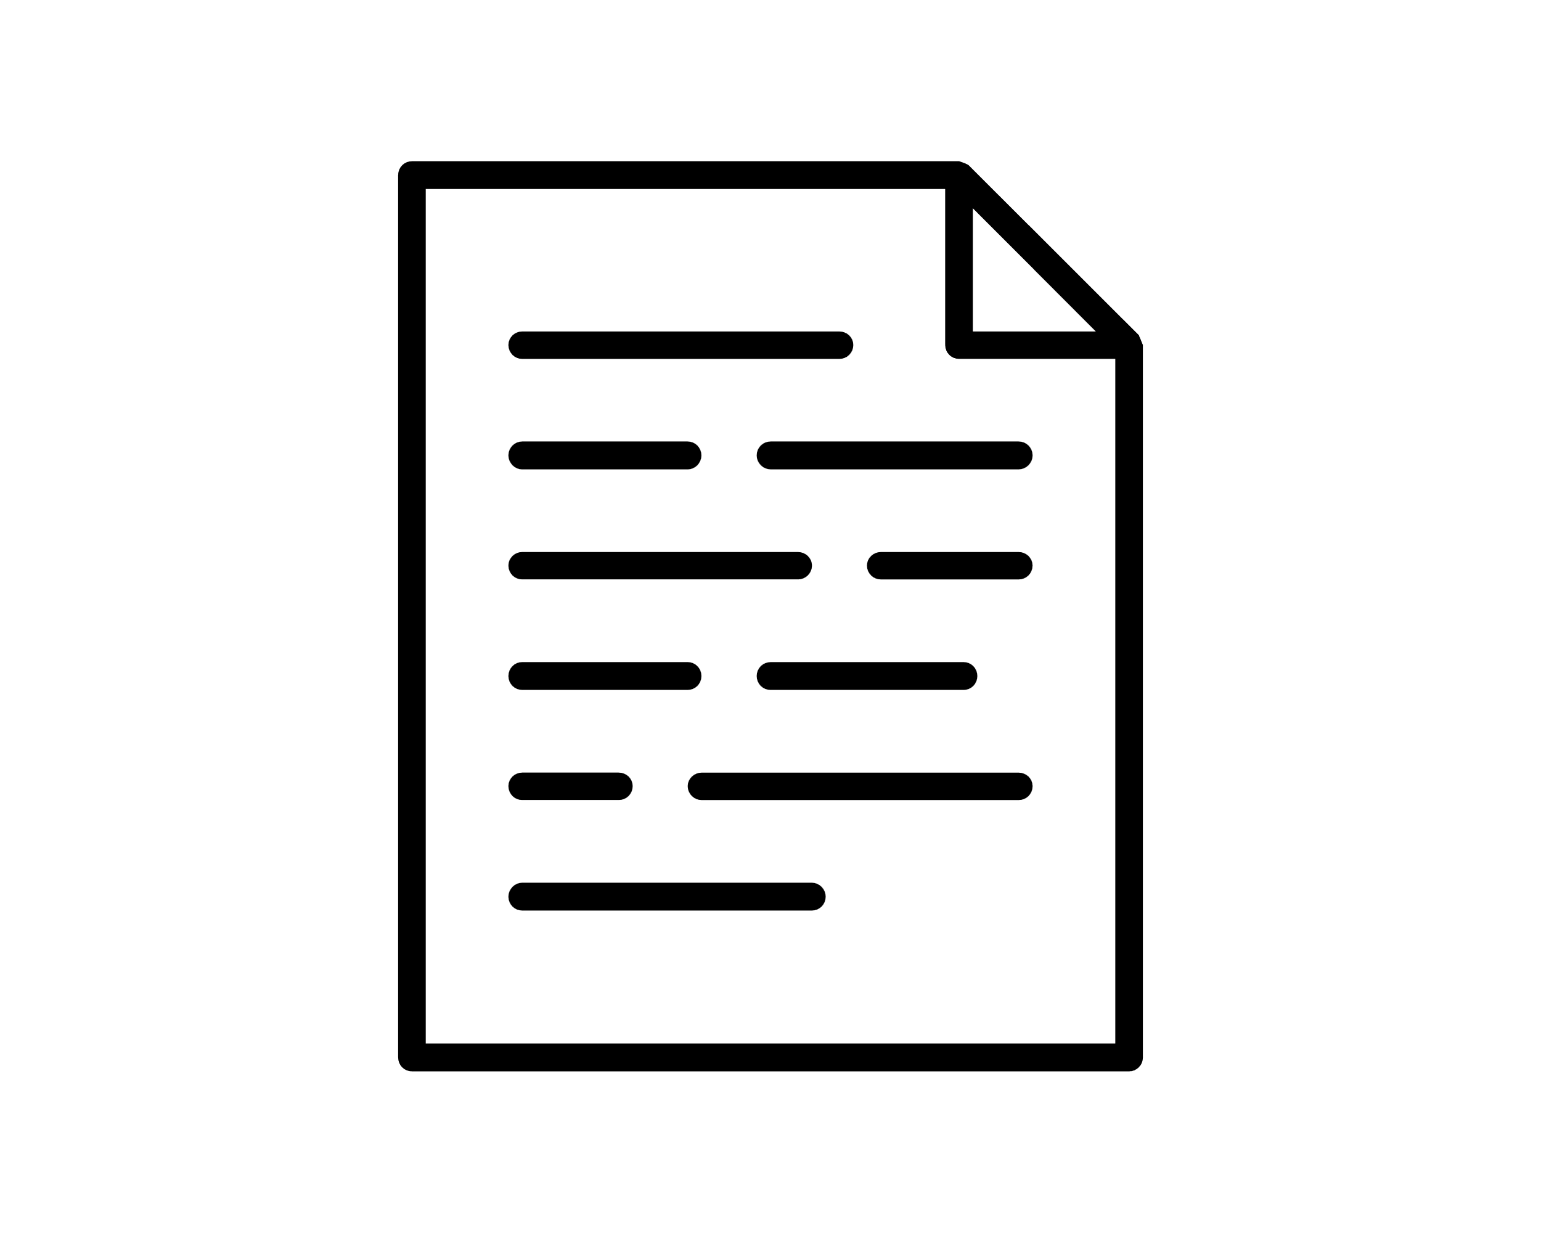











“More generous gifting behaviour in
greener neighbourhoods”
Notes:
Paper by Egi Maulana from <a href="https://thenounproject.com/browse/icons/term/paper/" target="_blank" title="Paper Icons">Noun Project</a>

Slide 7


Notes:
Scientist by Justicon from <a href="https://thenounproject.com/browse/icons/term/scientist/" target="_blank" title="Scientist Icons">Noun Project</a>
Question by Anggara Putra from <a href="https://thenounproject.com/browse/icons/term/question/" target="_blank" title="Question Icons">Noun Project</a>

Slide 8
my_data <- read_csv("super_private_data_file.csv")

Slide 9
Open data not allowed, options:
Data just not available, good luck
“Data available upon reasonable request”
Data is part of a large project with data access procedures
I just want to check out the script to learn from the cool analysis!
Solution: publish open synthetic data with your open materials

Slide 10
What will we do this morning?
A primer on synthetic data
Creating privacy-friendly synthetic data based on metadata
Pair programming in python
Creating & assessing high-utility synthetic data
Pair programming in R
Closing

Slide 11
A primer on synthetic data

Slide 12
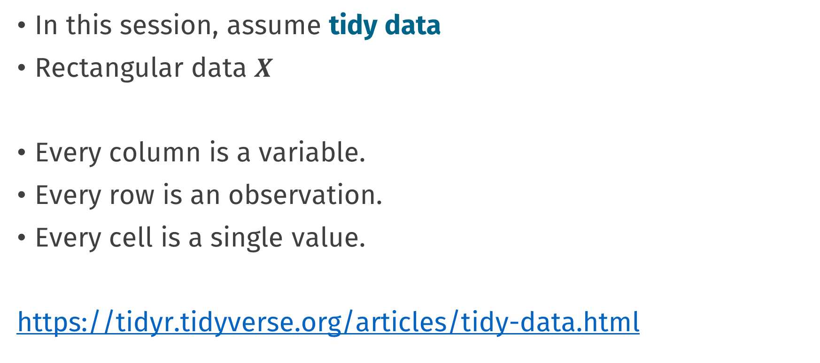
Preface: tidy data
In this session, assume tidy data
Rectangular data $X$
Every column is a variable.
Every row is an observation.
Every cell is a single value.
https://tidyr.tidyverse.org/articles/tidy-data.html

Slide 13
Synthetic data (EJ’s definition)
Synthetic data is generated from a model
As opposed to real, natural, collected data
fake data
generated data
simulated data
digital twin
public use file

Slide 14
To create synthetic data, you need a generative model

Slide 15
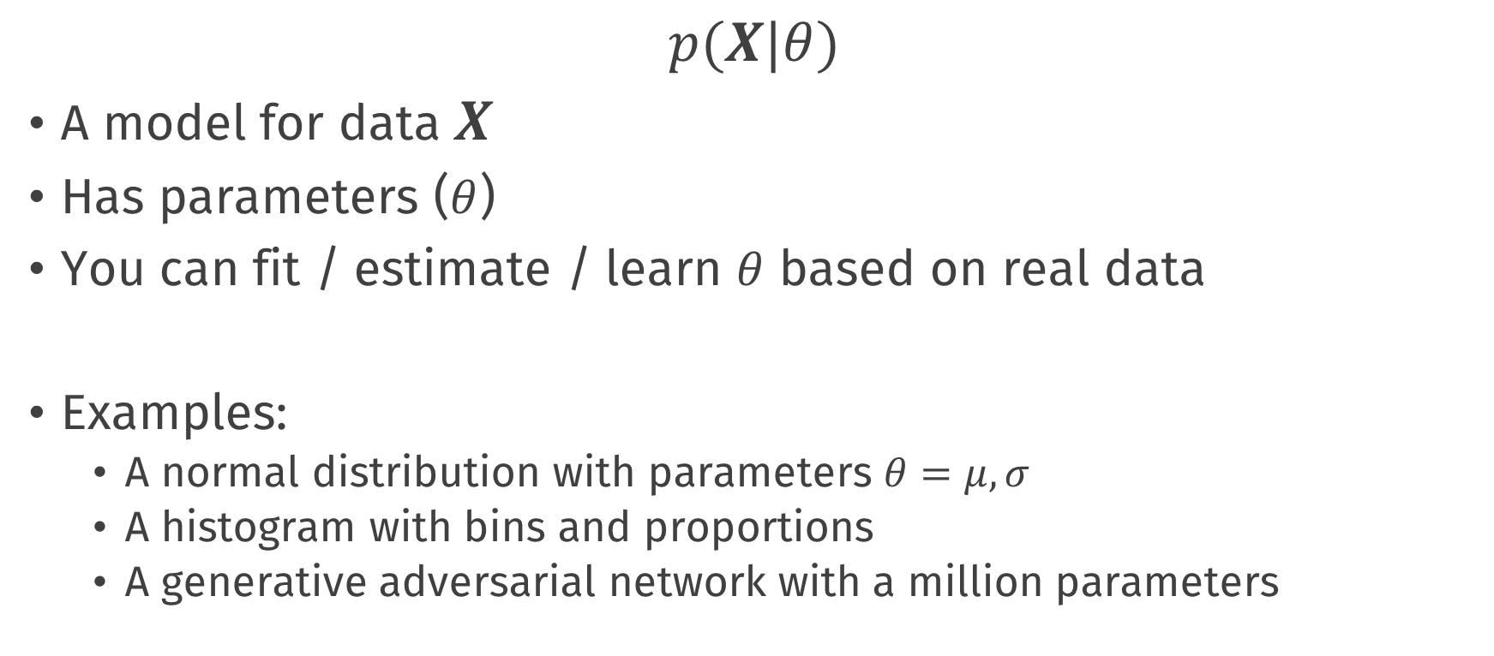
Generative model
$$p(X|θ)$$
A model for data $X$
Has parameters ($θ$)
You can fit / estimate / learn $θ$ based on real data
Examples:
A normal distribution with parameters $θ=μ, σ$
A histogram with bins and proportions
A generative adversarial network with a million parameters

Slide 16
Generative model
In R code:
# parameters
mu <- 1.0
sigma <- 1.5
# generate data
x_sim <- rnorm(100, mean = mu, sd = sigma)

Slide 17
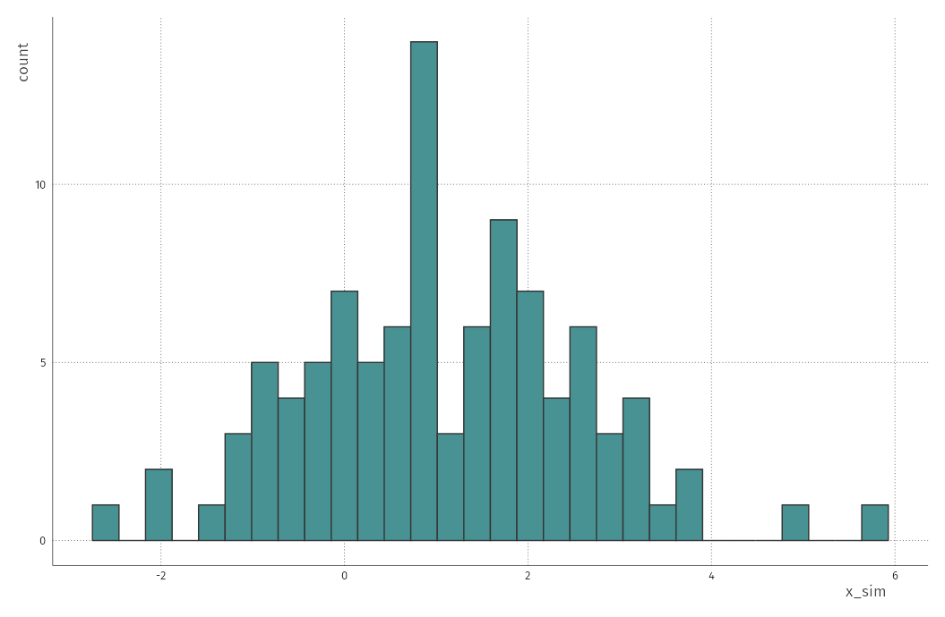

Slide 18
Generative model
Today we will fit two types of generative models:
Metasynth: automatically selected univariate parametric distributions for each variable in your data
Synthpop: Fully conditional nonparametric classification and regression trees to model the whole dataset
There are infinitely many more generative models. This is an active field of research

Slide 19
How to make sense of all of these models for creating synthetic data in the real world?

Slide 20
The privacy-utility tradeoff

Slide 21
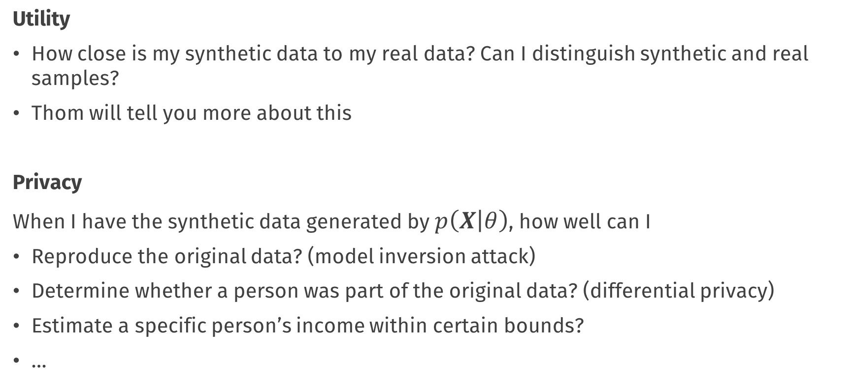
Utility vs. privacy
Utility
How close is my synthetic data to my real data? Can I distinguish synthetic and real samples?
Thom will tell you more about this
Privacy
When I have the synthetic data generated by $p\left(X | θ\right)$, how well can I
Reproduce the original data? (model inversion attack)
Determine whether a person was part of the original data? (differential privacy)
Estimate a specific person’s income within certain bounds?
…

Slide 22
Utility vs. privacy
Every parameter in the data-generating model contains information about the observations in the real data
The more parameters (information) you use to generate synthetic data, the more utility it will have
When the information in the parameters equals the information in the real data, we have just recreated the real data
At that point, there is no more privacy / disclosure control

Slide 23
Utility and privacy are opposites

Slide 24
How much does the synthetic data look like the real data?
I don’t know what I’m looking at
Perfect imitation
Utility
Privacy

Slide 25
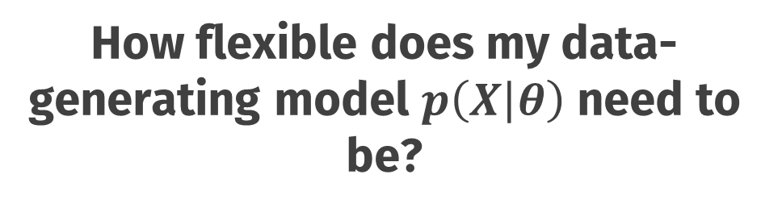
How flexible does my data-generating model $p\left(X | θ\right)$ need to be?
flexible
inflexible
Utility
Privacy

Slide 26
How flexible does my data-generating model $p\left(X | θ\right)$ need to be?
Huge classification and regression tree
Copula models
Just put 0 everywhere
Generative adversarial network with privacy penalties
Independent univariate
flexible
inflexible
Utility
Privacy
Fully conditional specification (mice, synthpop)

Slide 27
What can we do with the synthetic data?
Anything you can do with real data
Nothing
Utility
Privacy

Slide 28
What can we do with the synthetic data?
Investigate & answer all your research questions
Getting to know the data
Use the data as a toy example
Develop & validate data analysis scripts and pipelines
…
Find out how much your colleagues earn
Anything you can do with real data
Basic correlation analysis
Nothing
Utility
Visualisation of association
Privacy
Visualisation of variation
Estimate parameters with low simulation error

Slide 29
Different methods for different use-cases

Slide 30
Let’s get started!
synthpop
metasynth
Utility
Privacy

Slide 31
Icons from the noun project
Scientist by Justicon
Idea by Icon
house tree by LUTFI GANI AL ACHMAD
Euro by Larea
people by Alice Design
Table by Alex Burte
Hacking by Alfredo
Paper by Egi Maulana
Scientist 2 by Justicon
Question by Anggara Putra
https://thenounproject.com/

Slide 32
Conclusions

Slide 33
Default light slide
Default subheading
This is the body of the text
Default subheading
Note that the text is not black, but “black, text 1, lighter 25%”
Default subheading
This makes things easier on the eyes
Default subheading
This is the body of the text

Slide 34
Is this an impact slide?

Slide 35
Default light slide
This is the body of the text

Slide 36
Default dark slide
Default subheading
The dark slide brings some variation
Default subheading
It can highlight important aspects of the presentation.
Default subheading
This is the body of the text
Default subheading
This is the body of the text

Slide 37
Is this an impact slide?

Slide 38
Here is an impactful slide with a sentence on it.
Here is a topic related to the aforementioned question.

